Slide 1
Name of the Student
Professor
Course
Date

Slide 2
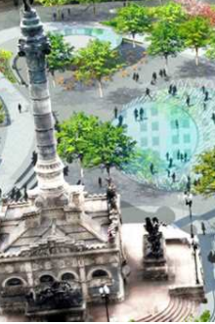
Location: Civic Center District, Cleveland
Absolute location- 41.5048° N, 81.6857° W
Relative location- Civic center district is at the heart of the city’s landmark skyscraper, Terminal tower
Located in the southeast of the of the historic ‘soldiers and sailors’ monument

Slide 3
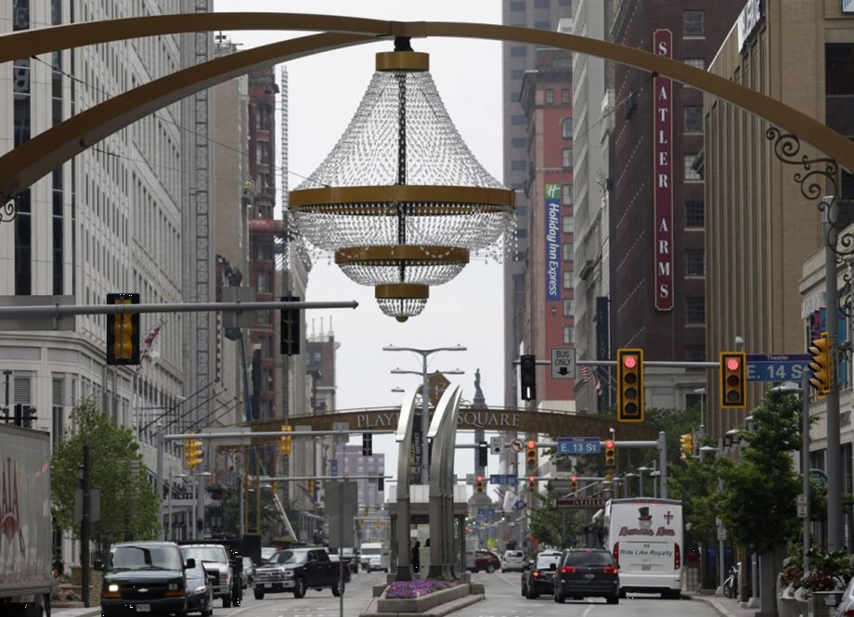
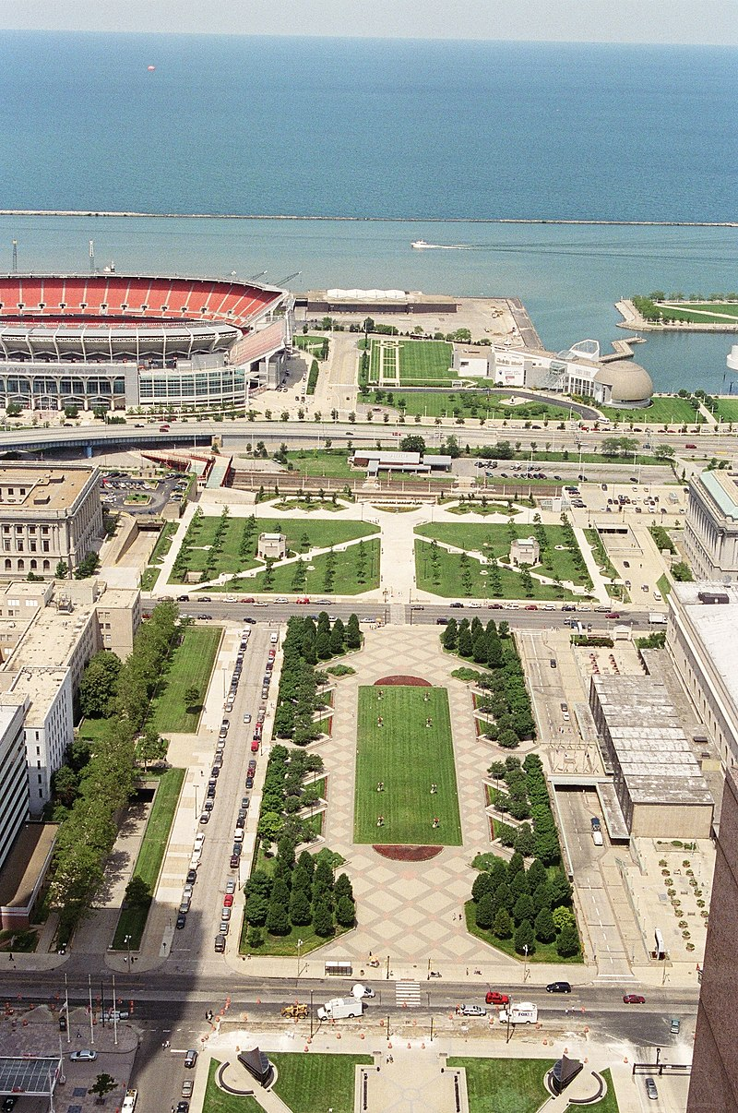
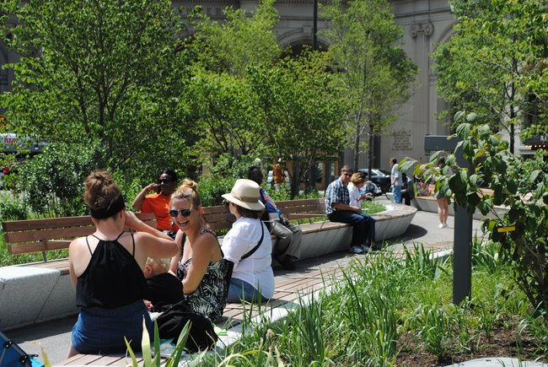
Place
The district is adjacent to playhouseSquire, which is the second largest performing arts center outside of Lincoln Center
The district is adjacent t Cleveland Mall pubic which has one of most beautify designs.
The district has a Cleveland public park which has a grassy Oasis

Slide 4
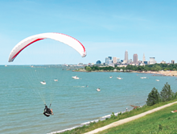
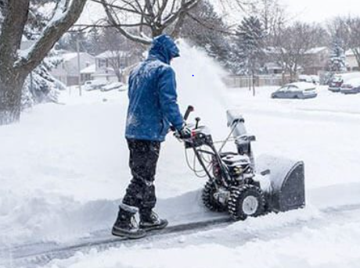
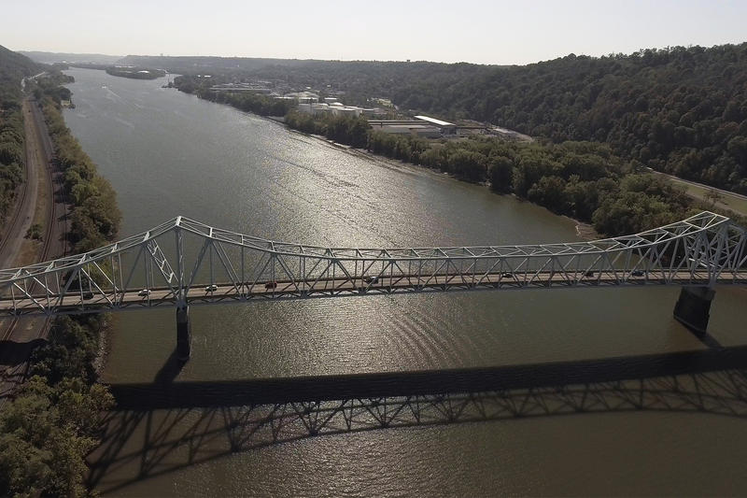
Human environment interaction
The summers are warm and people like to engage in outdoor recreational activities
During winter season, people are forced to dress in heavy clothing and adapt t cold environment
People utilize Ohio river for recreational activities

Slide 5

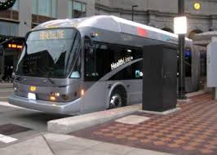
Movement
People mostly move by bus, trucks, trains, and air
The movement of information is through internet, Tv, radio, phones, books, magazines, and newspaper

Slide 6
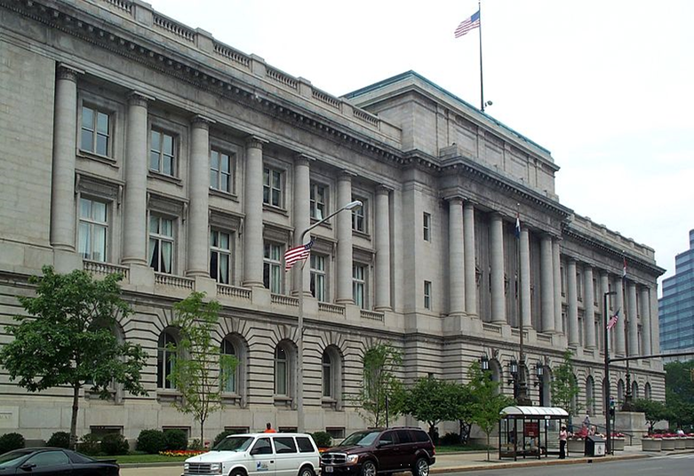
Regions
Cleveland city Hall is the most important region since it is the center for government operations
(CCD, 2021)

Slide 7
Refence
Civic Center District | Downtown Cleveland | Cleveland, OH | Cleveland, OH | This Is Cleveland. This Is Cleveland. (2021). Retrieved 17 February 2021, from https://www.thisiscleveland.com/about-cle/downtown-cleveland/civic-center-district.

